Slide 1
ANALYTICA

Slide 2
FLOW OF WORK
01
02
03
Relevant information retrieval
Question generation with model
Text extraction form pdf

Slide 3
FLOW OF WORK
04
05
Prompt matching and Question Generation
A main function processing all functions

Slide 4
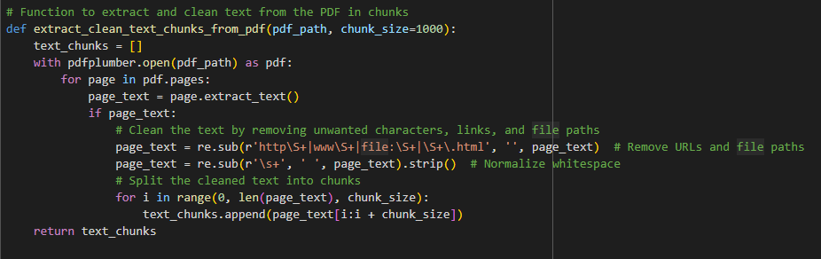
Flow of work:
PDF text extraction using pdfplumber

Slide 5
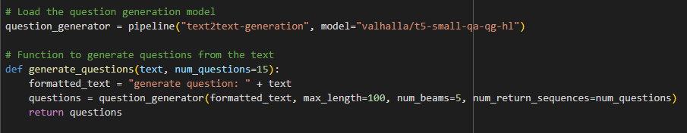
Flow of work:
2. Question Generation using transformer library

Slide 6
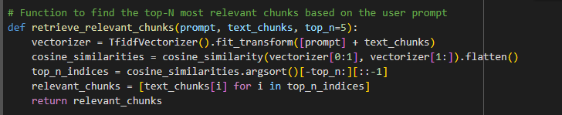
Flow of work:
3. Retrieving relevant information using RAG

Slide 7
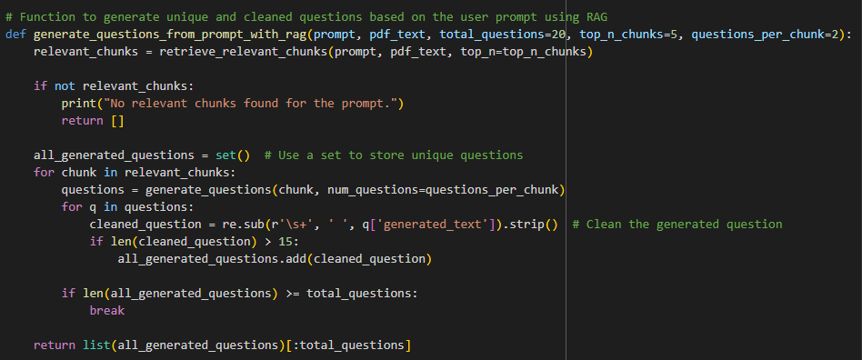
Flow of work:
4. Prompt matching and question generation

Slide 8
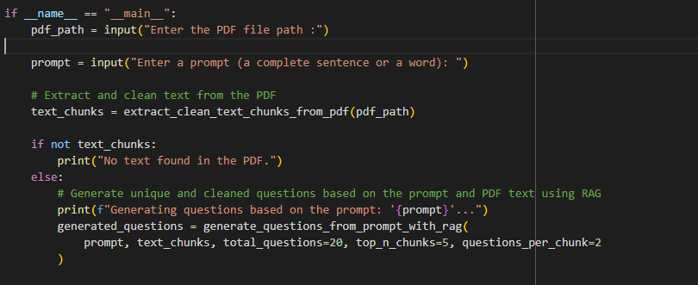
Flow of work:
5 . A main function processing the above functions

Slide 9
RAG (Retrieval Augmented Generation)
Retrieval Augmented Generation (RAG) is a hybrid approach combining information retrieval techniques with generative models to enhance the quality and accuracy of content generation. The main idea behind RAG is to improve the output of generative models like GPT (which might not always produce factually correct or relevant content) by allowing them to retrieve relevant information from external sources or databases before generating a response.

Slide 10
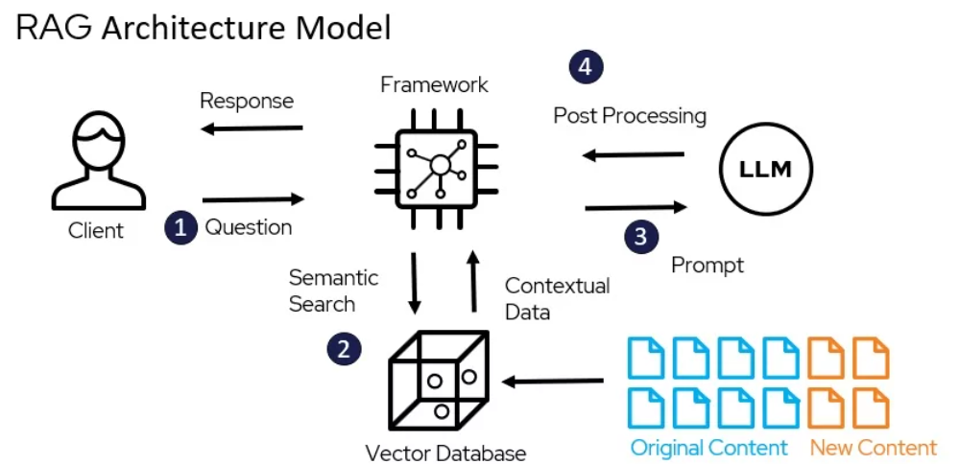
UNDERSTANDING THE PROBLEM
MARS
VENUS
Despite being red, Mars is a cold place. It’s full of iron oxide dust, which gives the planet its reddish cast
Venus has a beautiful name and is the second planet from the Sun. It’s terribly hot, even hotter than Mercury

Slide 11
Our solution for hindi and sanskrit
Translated the pdf text with the help of Google translate library
Translated the prompt
Processed the text and prompt and generated questions
Translated back the questions to native languages

Slide 12
Thank You
1
Submission By-
Team GUCCHI GANG
IIIT NAGPUR

